Slide 1
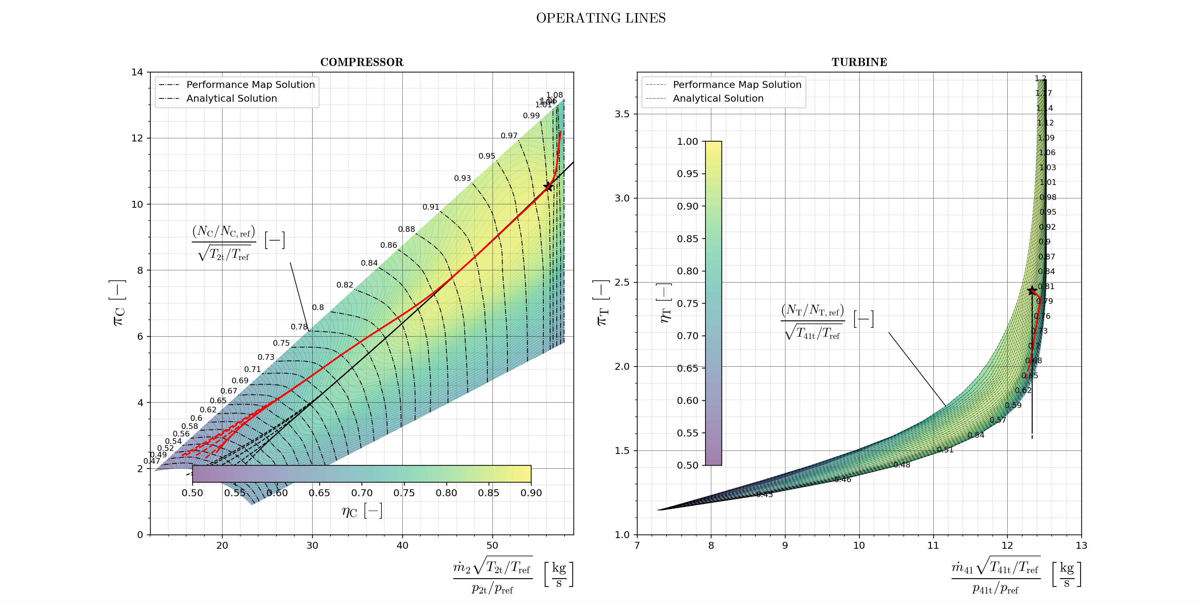
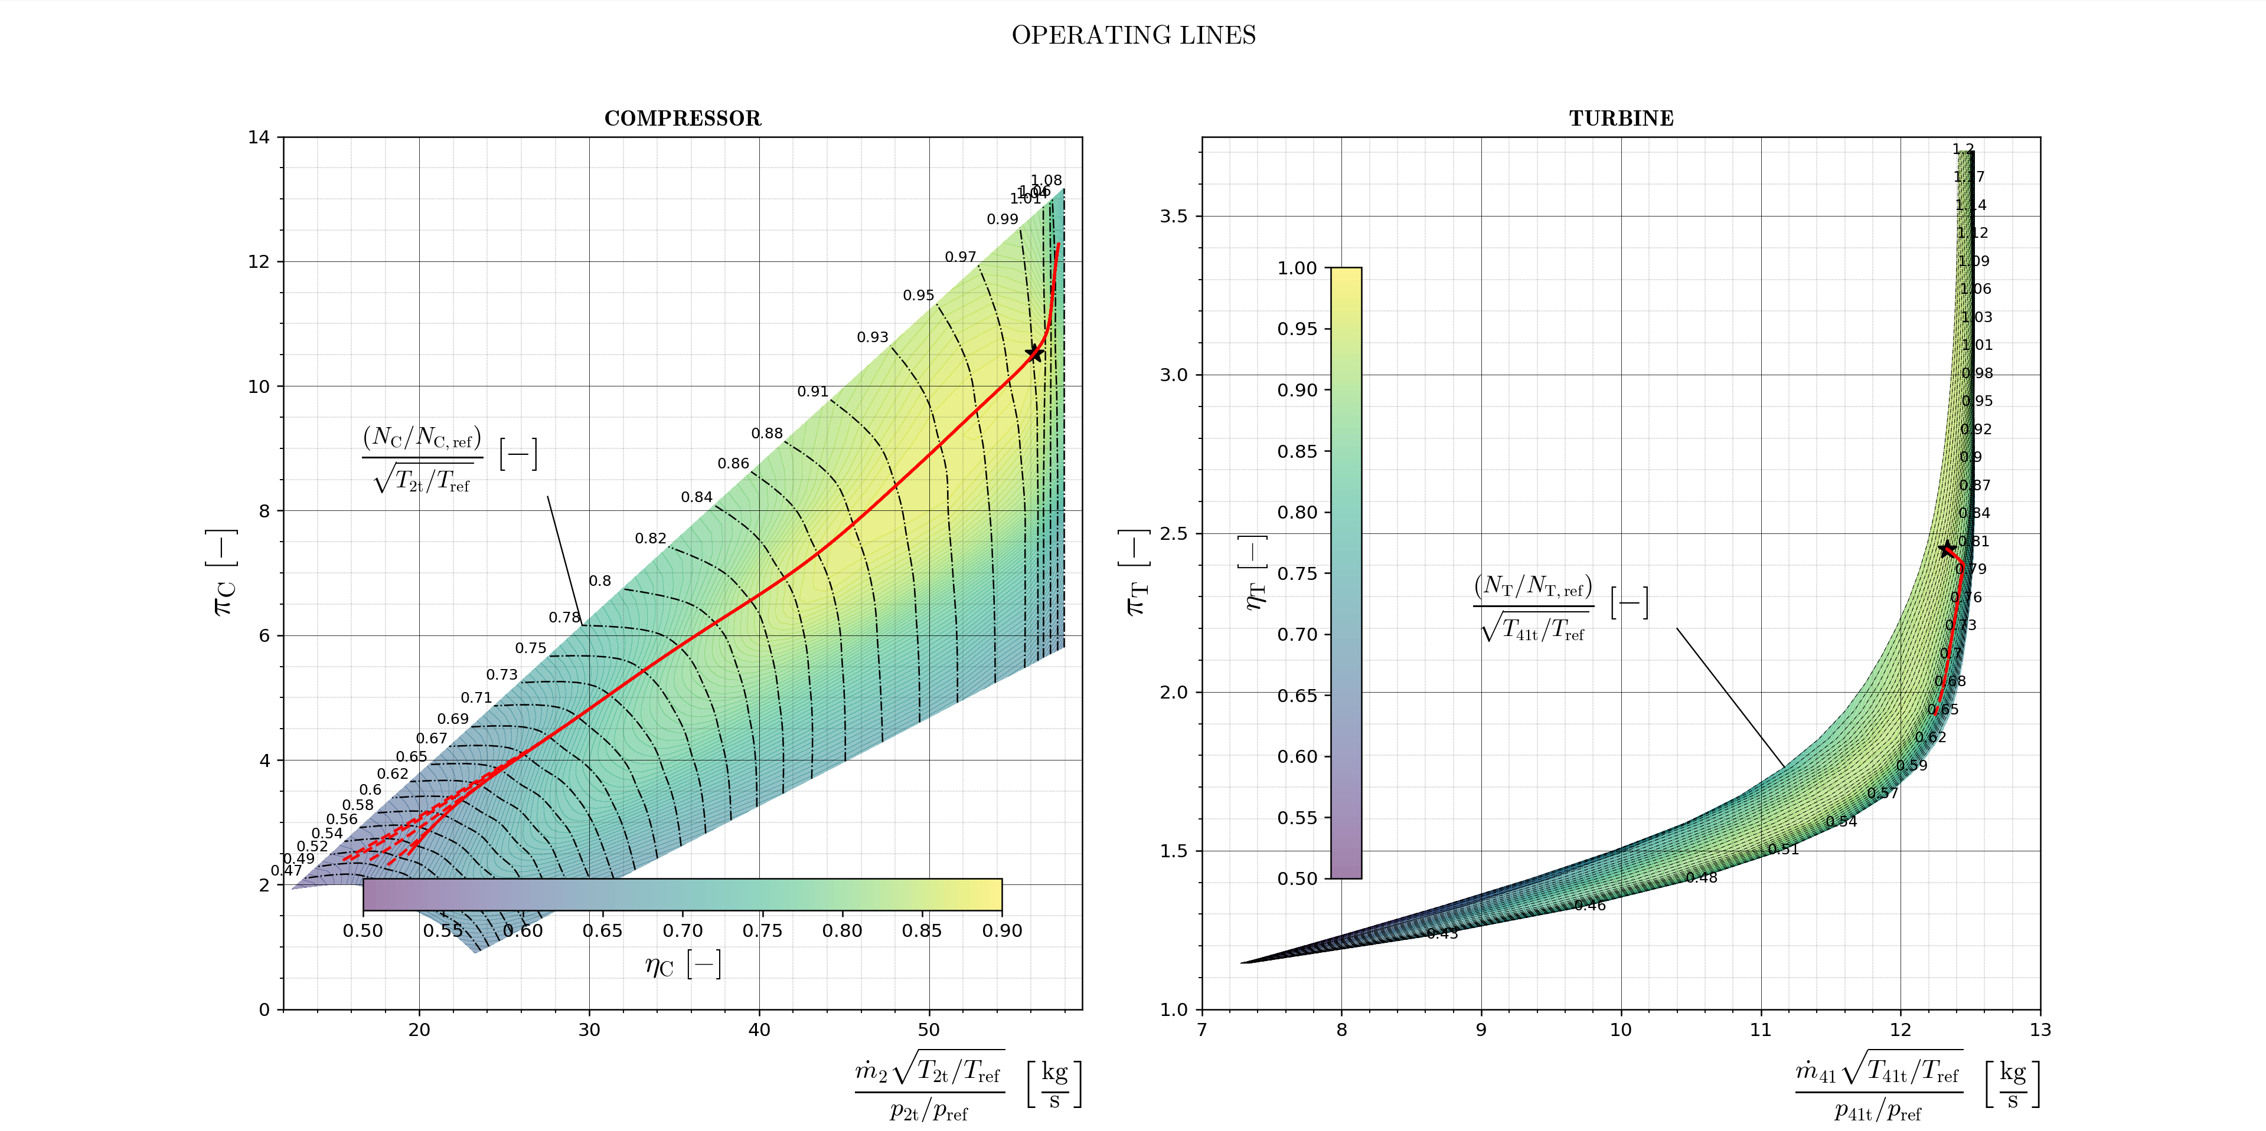
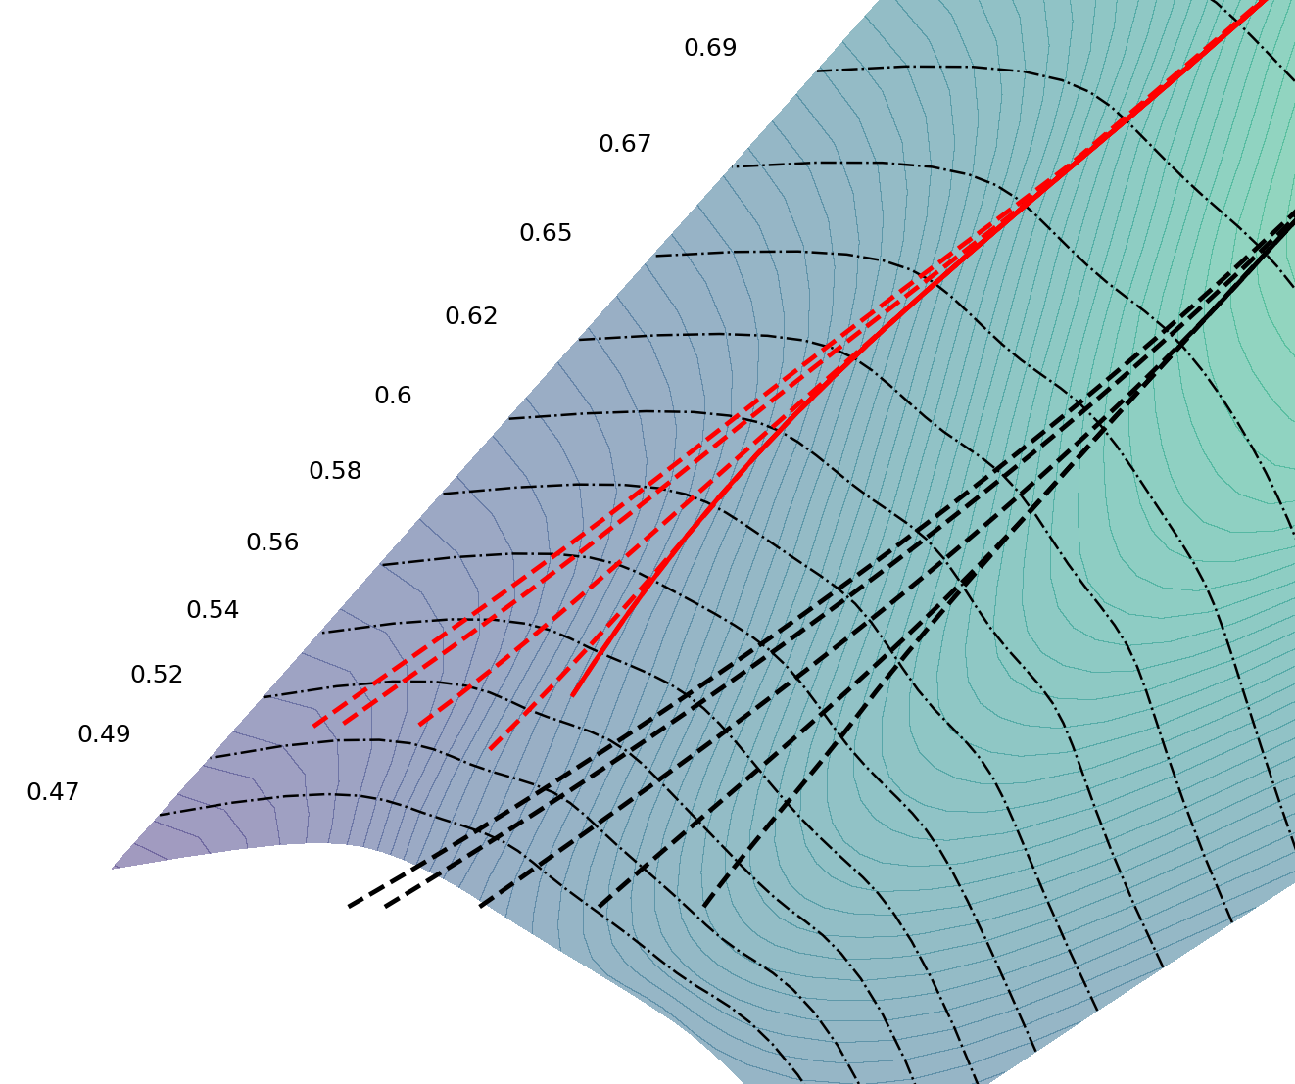
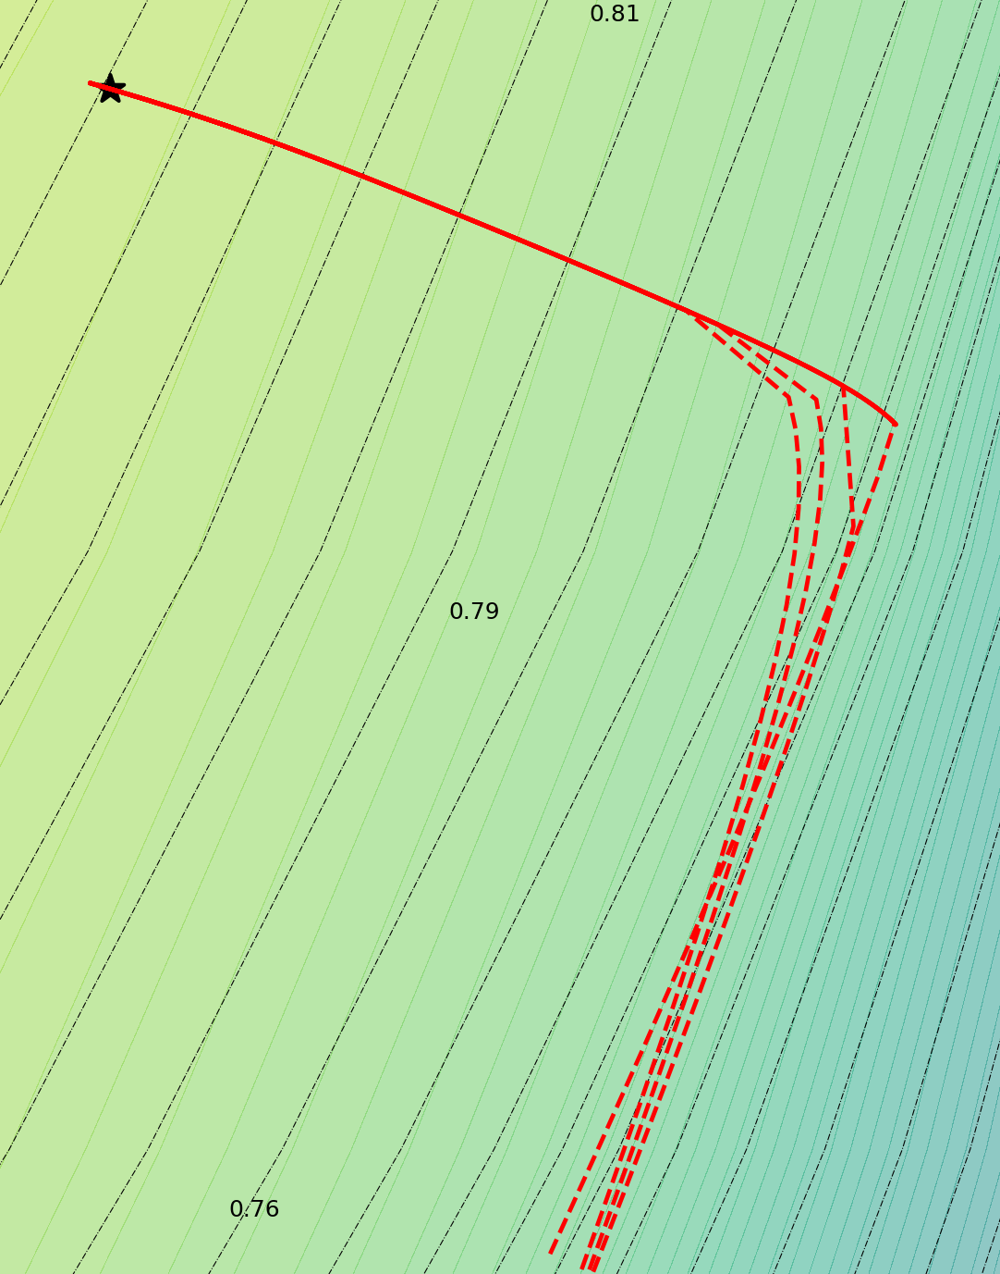
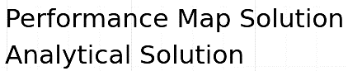
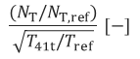
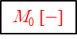
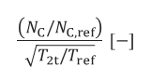
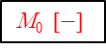
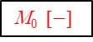
CHOKED NOZZLE SUBSONIC NOZZLE
M₀ $[−]$
0.69
0.81
M₀$[−]$
M₀$[−]$
0.65
$$\frac{\left(N_{C}/N_{C,ref}\right)}{\sqrt{T_{2t}/T_{ref}}} [−]$$
0.25
0.60
0.0
0.5
0.54
1.0
0.0
0.5
0.25
1.0
0.79
0.47
0.75
0.0
0.5
0.75
0.25
1.0
0.77
0.75
$$\frac{{(N}_{T}/N_{T,ref})}{\sqrt{T_{41t}/T_{ref}}} [−]$$

Slide 2

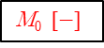
CHOKED NOZZLE SUBSONIC NOZZLE
M₀$[−]$
0
0.5
1
0.5
1
0

Slide 3
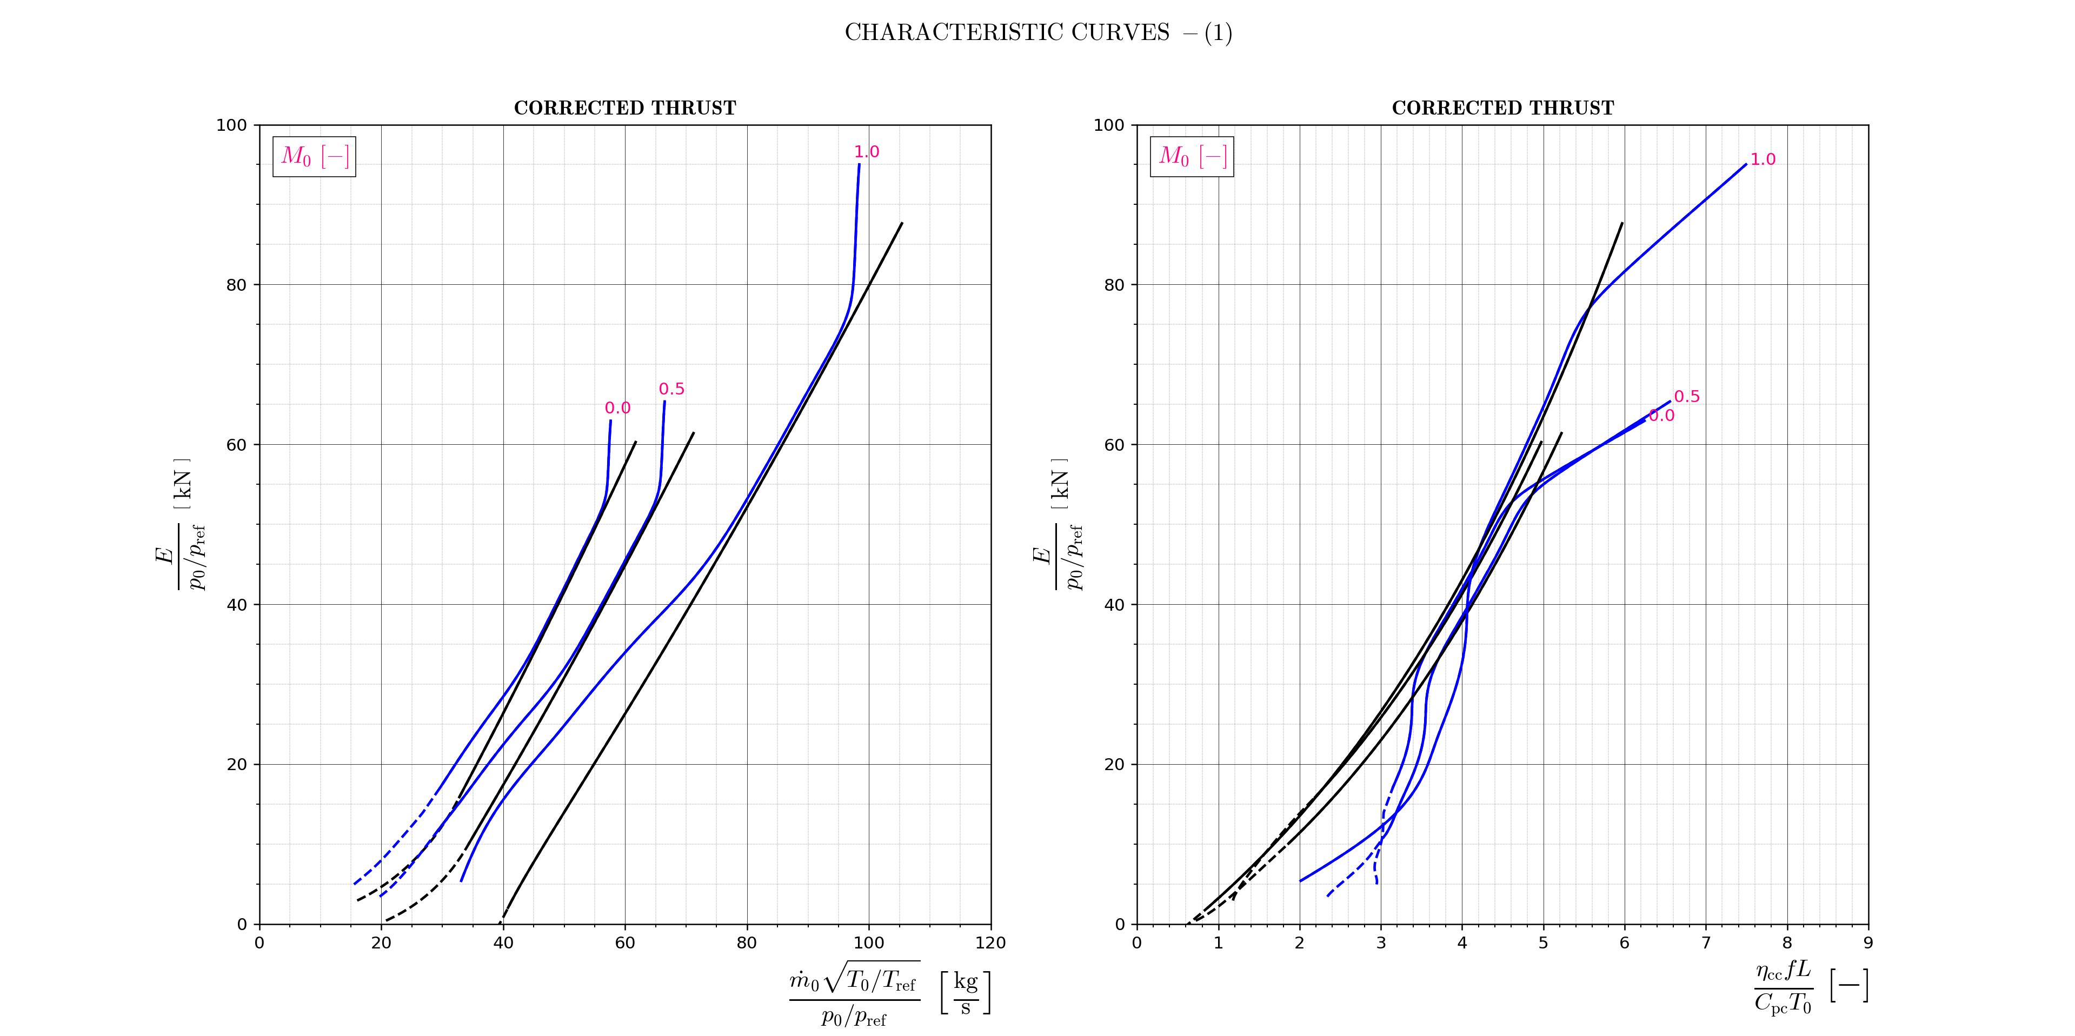
1.0
1.0
0.0
0.5
0.0
0.5

Slide 4
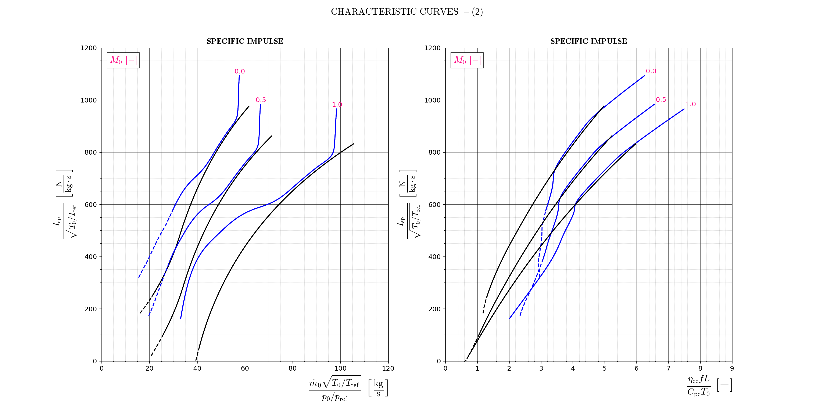
0.0
0.0
0.5
0.5
1.0
1.0

Slide 5
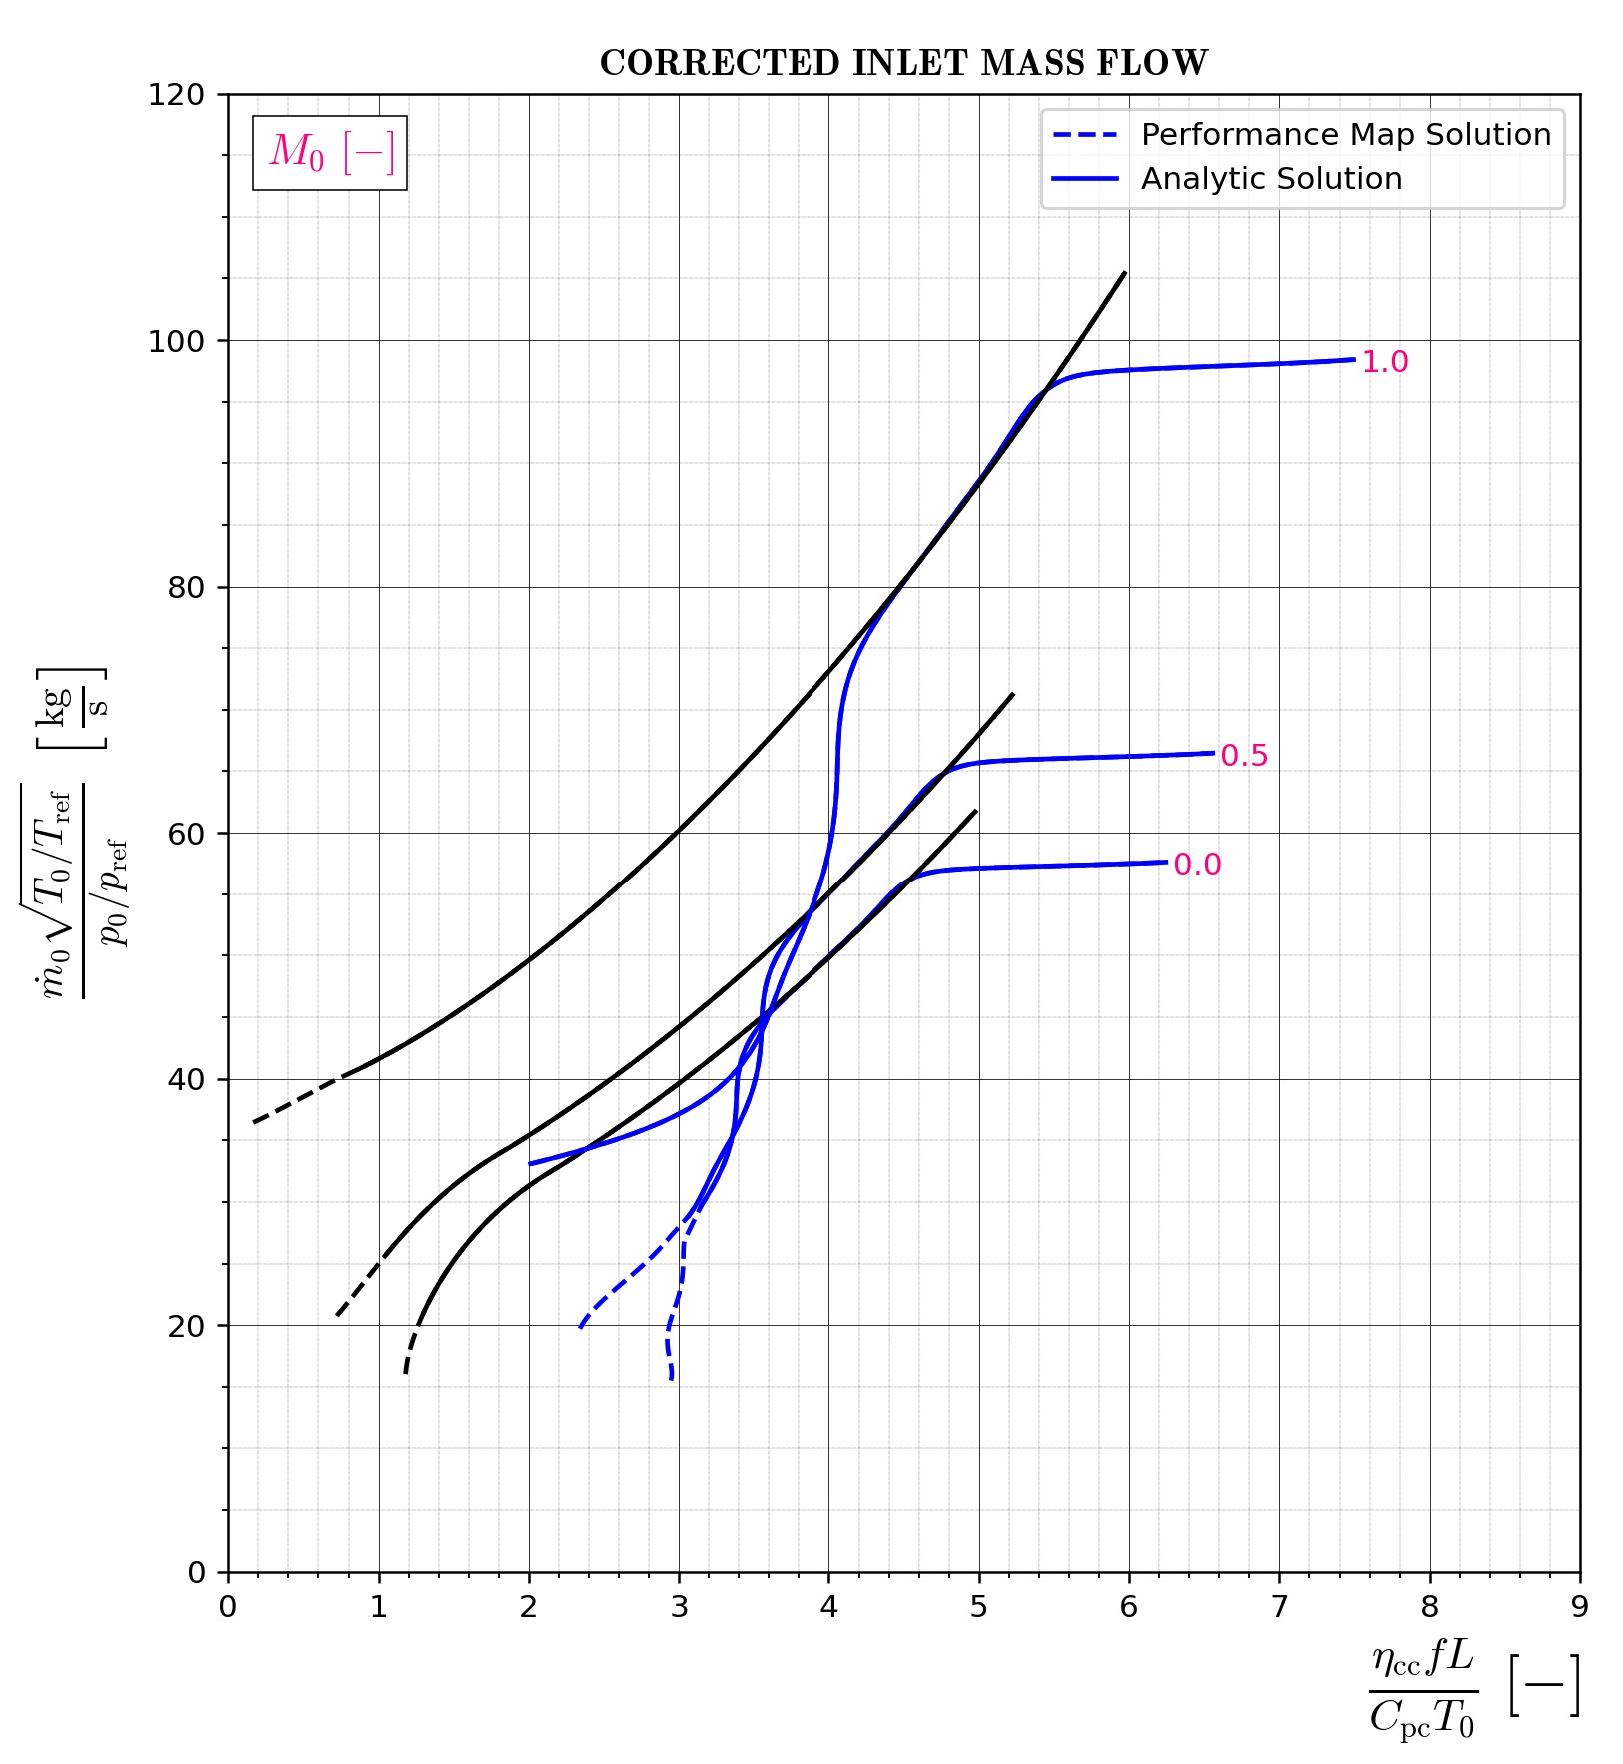
1.0
0.5
0.0

Slide 6
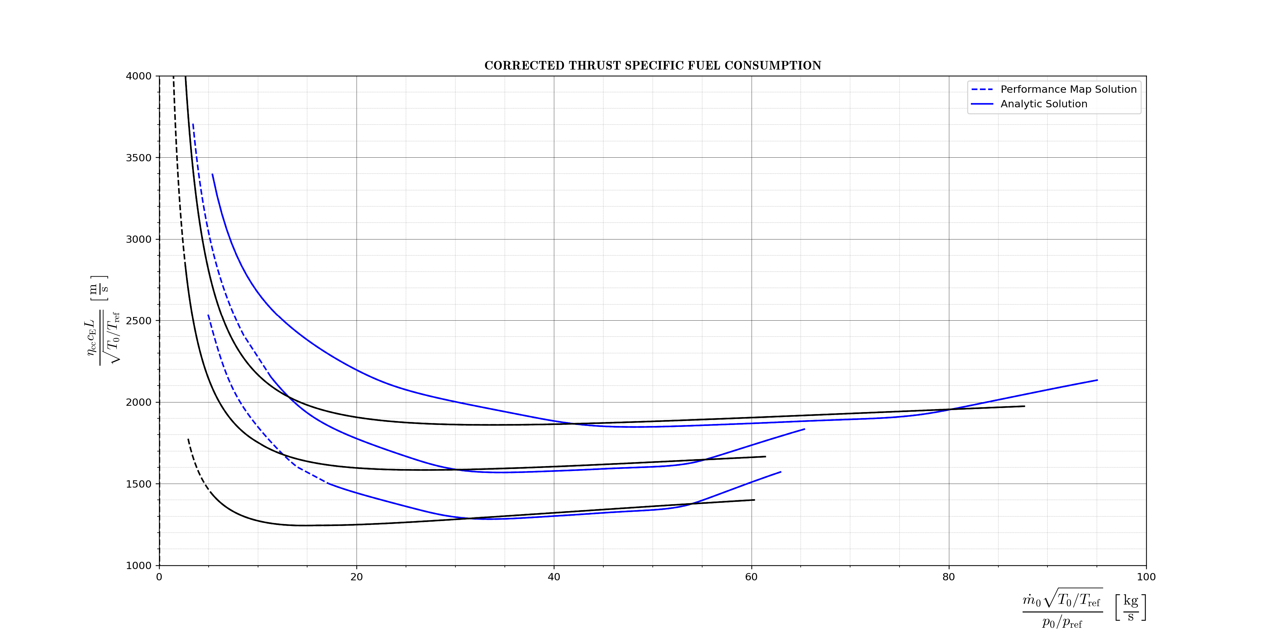
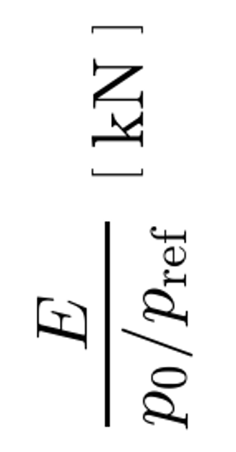
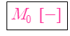
M₀$[−]$
1.0
1.0
0.5
0.5
0.0
0.0

Slide 7
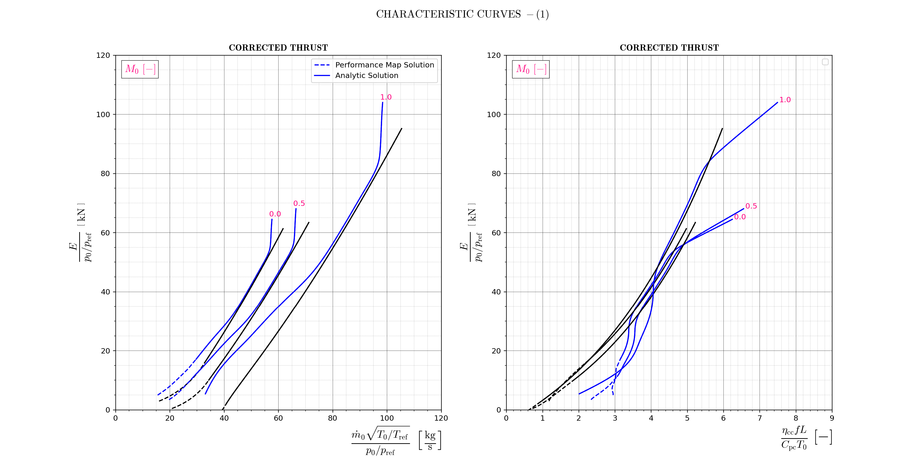
1.0
1.0
0.5
0.0
0.0
0.5

Slide 8
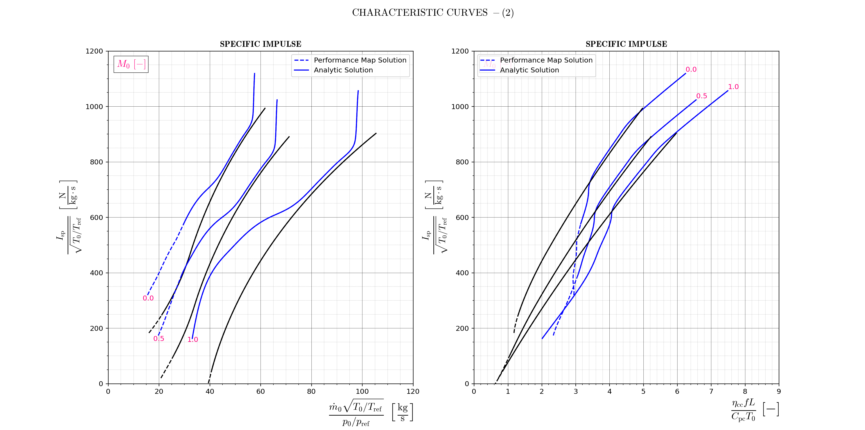
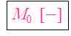
M₀$[−]$
0.0
0.0
0.5
1.0
0.5
1.0

Slide 9
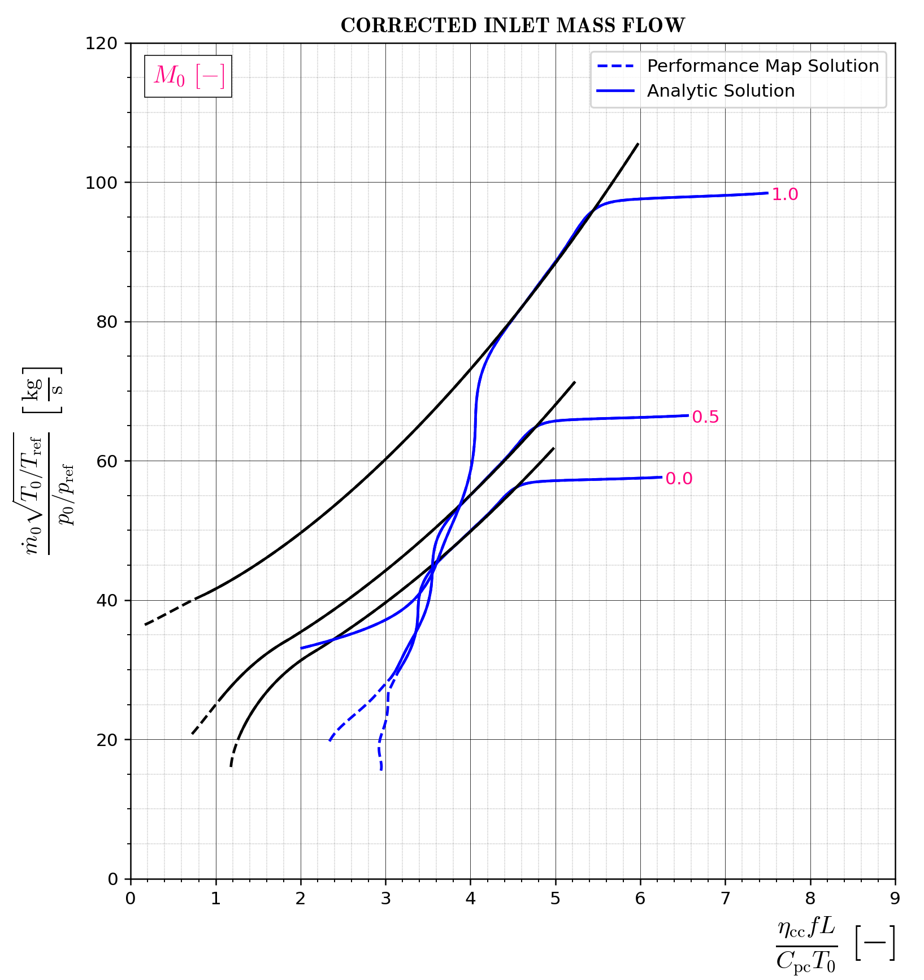
1.0
0.5
0.0

Slide 10
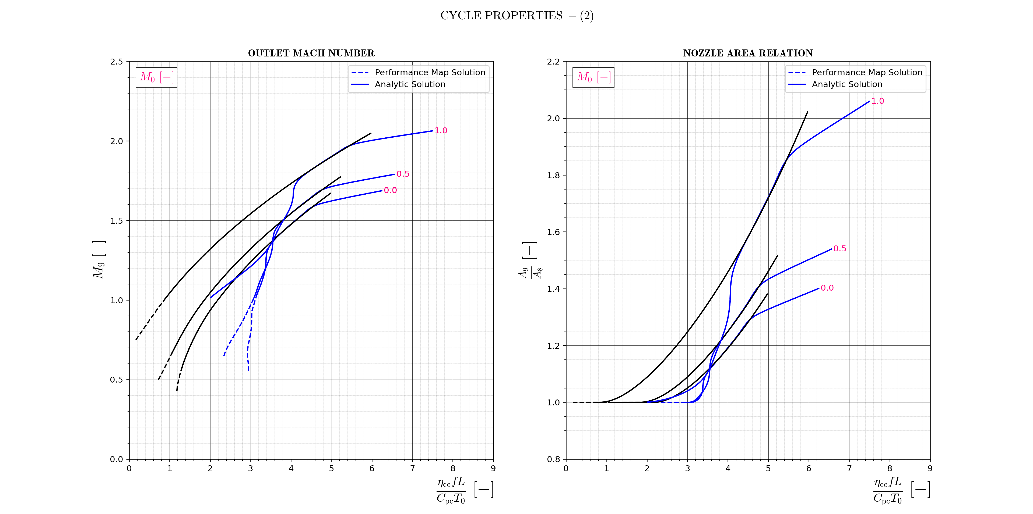
1.0
1.0
0.5
0.0
0.5
0.0

Slide 11
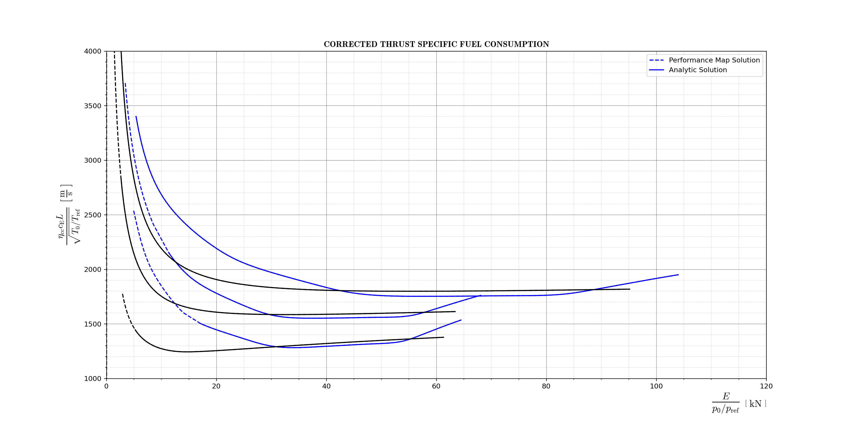
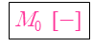
M₀$[−]$
1.0
0.5
1.0
0.5
0.0
0.0

